Slide 1
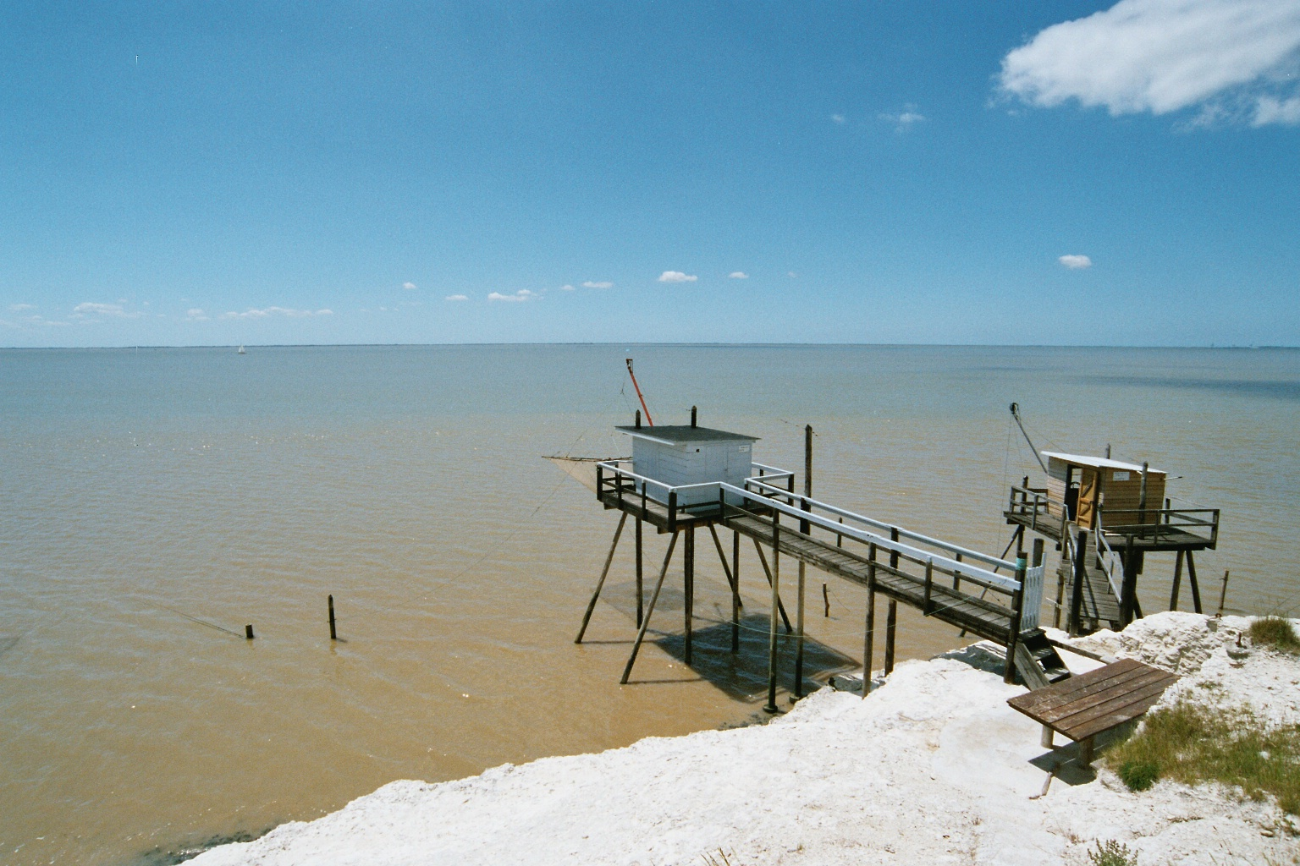

Fish in estuaries
Master MER • Bordeaux • 13 octobre 2020
Jérémy Lobry - jeremy.lobry@inrae.fr
Florence Mounier - florence.mounier@inrae.fr
INRAE – Nouvelle-Aquitaine Bordeaux Center
French National Research Institute for Agriculture, Food and Environment
Research Unit EABX - "Aquatic Ecosystems and Global Changes"
50 avenue de Verdun, F33612 Cestas Cedex, France
+33 (0)5 57 89 08 32
www.inrae.fr

Slide 2



Learning support
Clic
On several slides you will find links leading you to web contents:
Clic on this logo to watch a video.
Don’t forget to use the subtitle function when necessary.
Clic on this logo to read an article.
Simply put this slideshow in full screen and follow the presentation with your computer mouse
(or the arrows on your keyboard if you want to go back)
…and let yourself be guided by the animations !
Clic

Slide 3
Learning objectives
Estuarine habitat
  Identify the factors of the estuarine environment structuring the ichtyological biodiversity and apprehend their variability (gradients, seasons...)
Fish assemblages in estuaries
  Describe the fish assemblages in estuaries from different perspectives (morphology, trophy, ecology, life cycle....)
  Understand and describe the life cycles of marine and amphihaline fish in estuaries
  Identify environmental issues
Potential effects of global changes
  Using the Gironde estuary as an example, understand how global changes can affect biodiversity (especially fish)

Slide 4
Introduction

Slide 5

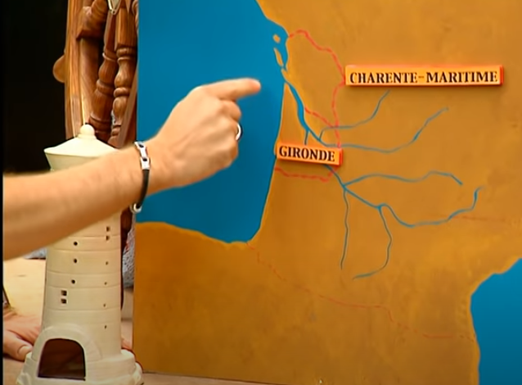
Introduction
A transition area between ocean and river
OCEAN
RIVER
(7min)
Example of the Gironde estuary
04’05 (5min)

Slide 6
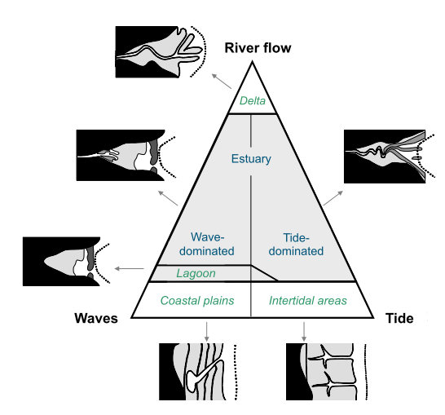
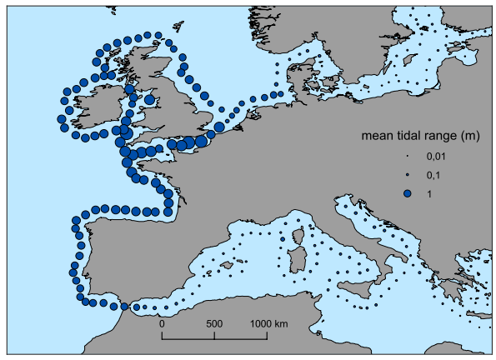
Introduction
Environmental factors structuring the estuarine habitat
Tide
Micro-tidal estuary: tidal range < 2m (formation of a delta by the sediments, characteristic of closed seas)
Meso-tidal estuary: tidal range 2-4 m (shallow waters at the mouths)
Macro-tidal estuary: tidal range > 4m (wide mouth)
  => Tidal range
  => Geomorphological consequences
Savenije 1992
Harris & Heap 2003
Nicolas 2010

Slide 7
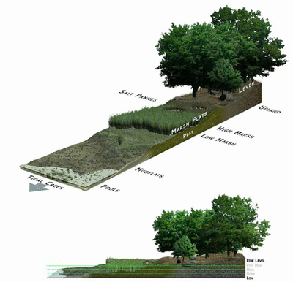
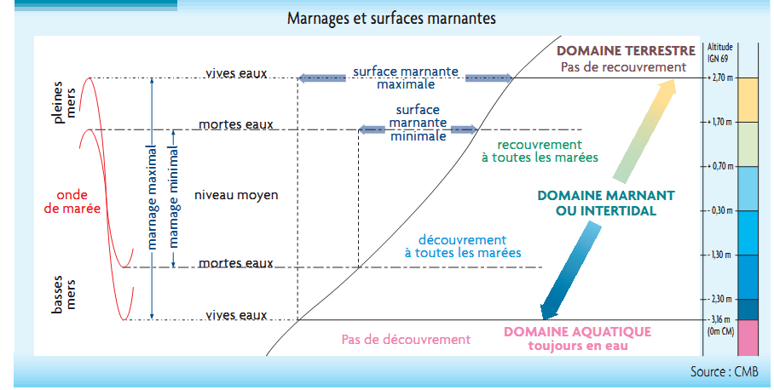
Introduction
Environmental factors structuring the estuarine habitat
Tide
  => Tidal range
  => Geomorphological consequences
  => Intertidal zone/area
Tidal range and intertidal areas
TERRESTRIAL ENV
No covering
spring tides
max intertidal area
high tides
neap tides
min intertidal area
covering at all tides
tidal propagation
max tidal range
mean level
min tidal range
INTERTIDAL ENV
neap tides
uncovering at all tides
low tides
spring tides
AQUATIC ENV
No uncovering

Slide 8
Introduction
Environmental factors structuring the estuarine habitat
Environmental gradients
  Salinity
  Temperature
  Suspended Particular Matter
From Romaña 1994
Suspended Particular Matter
« Maximum turbidity zone »
Salinity
Summer
Temperature
Winter
DOWNSTREAM
UPSTREAM

Slide 9
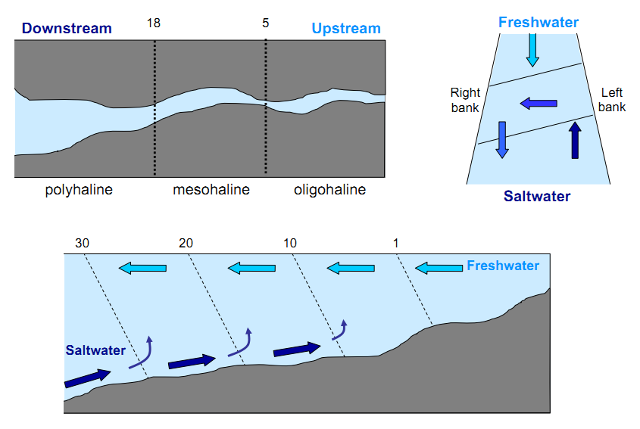
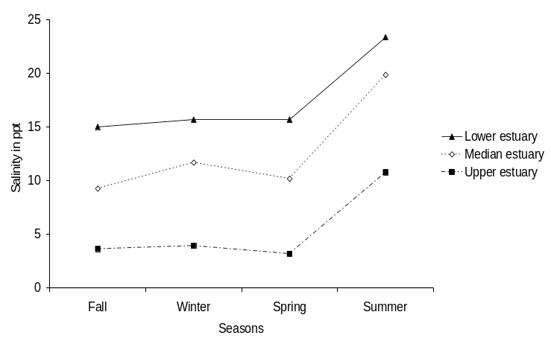
Introduction
Environmental factors structuring the estuarine habitat
Salinity gradients
  Different gradients
  Seasonal variations
Low river flows
McLusky & Elliott 2006

Slide 10
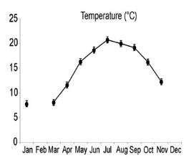
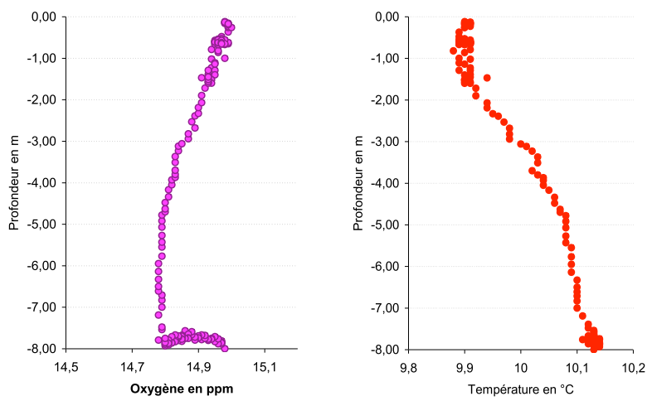
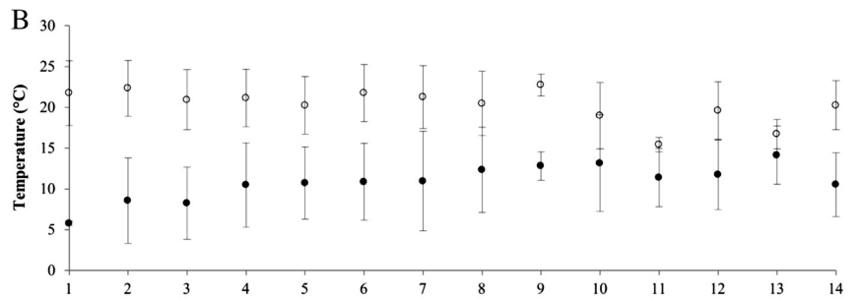
Introduction
Environmental factors structuring the estuarine habitat
  Seasonal variations
Temperature gradients
  Vertical gradient
Selleslagh 2012
  Longitudinal gradient
  Warming
Depth (m)
  2003
  1975
  Upstream
  Downstream
Temperature (°C)
Chaalali 2013

Slide 11
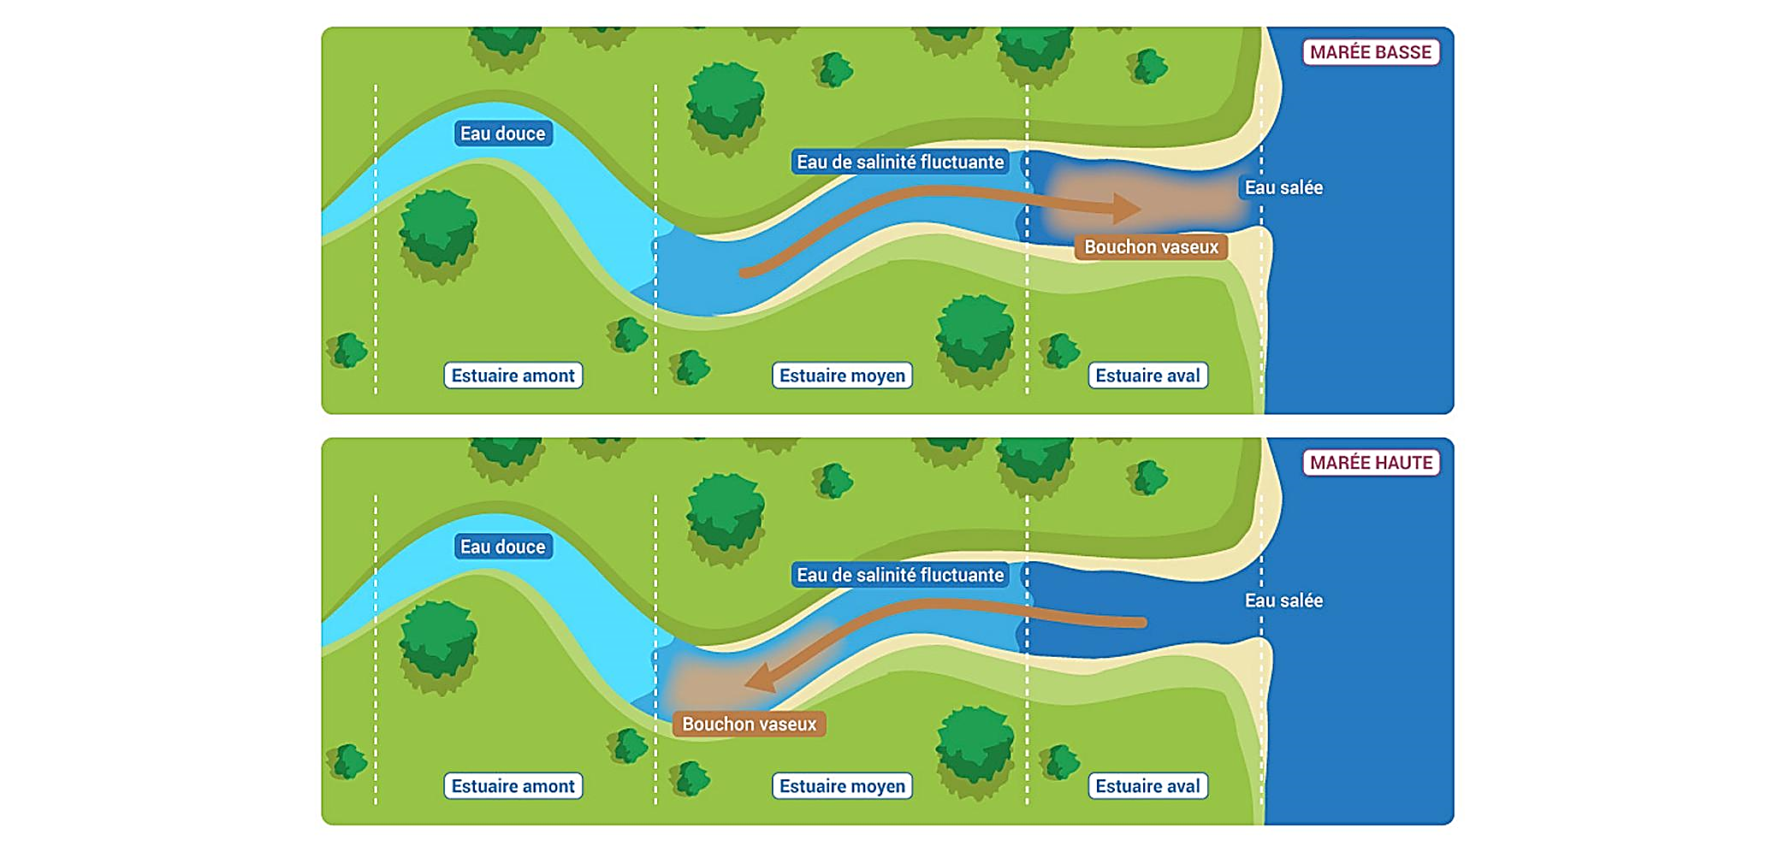
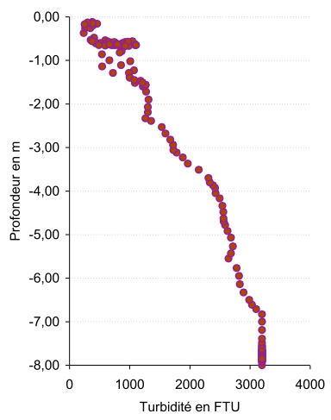
Introduction
Environmental factors structuring the estuarine habitat
Suspended Particular Matter gradients and maximum turbidity zone
  Vertical gradient
  Longitudinal gradient and tide
EBB TIDE
Fresh water
Fluctuating salinity
Salt water
Maximum Turbidity Zone
Depth (m)
Upstream
Middle estuary
Downstream
FLOOD TIDE
Fresh water
Fluctuating salinity
Salt water
Turbidity (FTU)
Maximum Turbidity Zone
Upstream
Middle estuary
Downstream

Slide 12
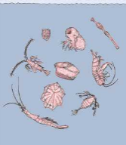
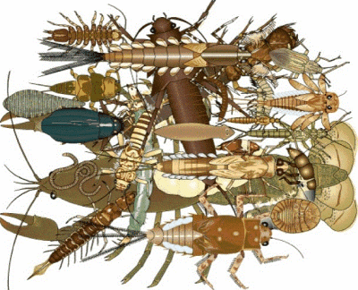
Introduction
High biological productivity
(Costanza et al. 1997 ; Mc Lusky 1989)
In a highly turbid estuary
Very low primary production
Zooplankton + High secondary production (benthos) but domination by a few species adapted to environmental constraints

Slide 13



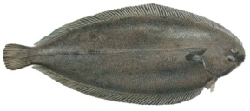

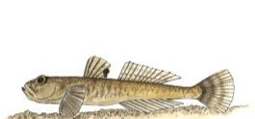
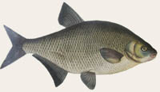
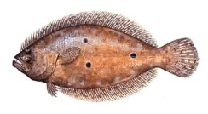

Introduction
Remarkable biodiversity
(Elliott & Dewailly 1995 ; Elliott & Hemingway 2002)
Diadromous
Ex. in the Gironde 75 fish species…
Freshwater
15%
Lobry et al. 2003
21%
Resident
3%
Marine
61%
Proportions in number of species
87% of the commercial and recreational fisheries value depend on species that spend all or part of their life in coastal and estuarine areas (OCDE, 1993)

Slide 14




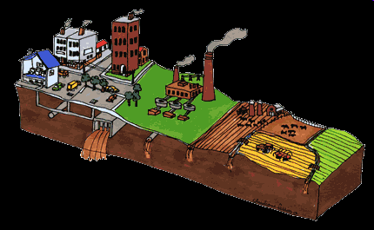




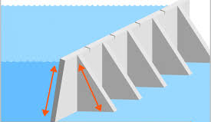

Introduction
At the convergence of global changes
(Hénocque & Denis 2001 ; Hoegh-Guldberg & Bruno 2010 ; Matthiessen & Law, 2002)
Climate change
Realignement,
Polderisation
Industrial activities
Agriculture
Dredging
Fisheries
Hydrodynamics
Agriculture
Urban areas
Dams

Slide 15


Introduction

Slide 16



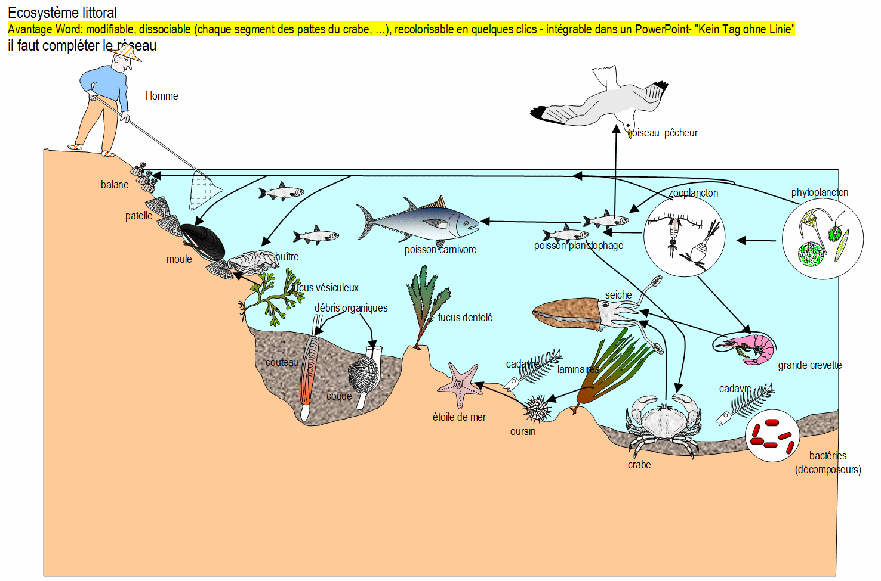



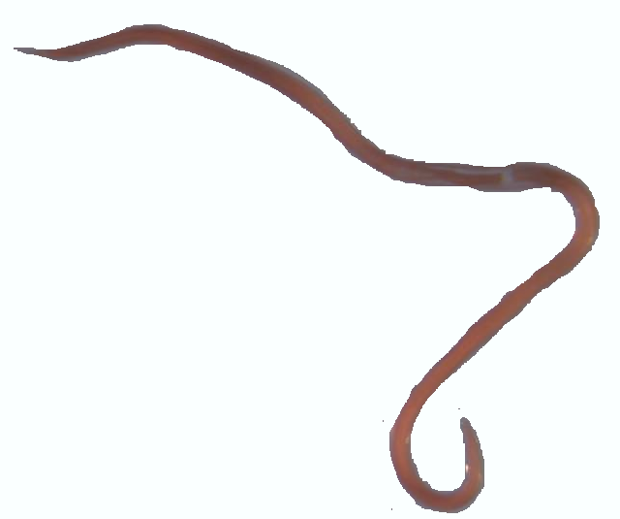



Introduction
Habitat
and its modifications
This course
?
Ecological communities
Structure
Species and functional diversity
Dynamics
Ecosystems
Functioning
Food web dynamics

Slide 17
1. The structure of estuarine fish communities

Slide 18

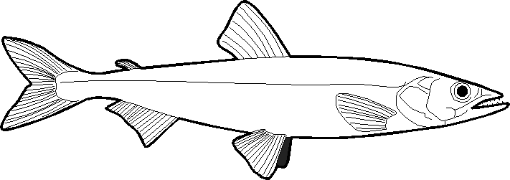

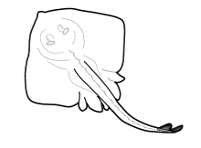

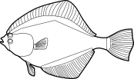


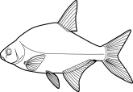

Environmental filters theory (Tonn et al., 1990; Keddy, 1992; Barbault, 1993)
From Lobry et al. 2003 ; Lobry et al. 2006 ; Thesis Delphine Nicolas 2010 ; Nicolas et al. 2010a ; Nicolas et al. 2010b ; Nicolas et al. 2011
Regional species pool
γ diversity
Regional
process
Dispersion barrier
Climatic conditions
Estuary
caracteristics
River discharge
Intertidal zones
Mouth width
Salinity gradient
Local
process
Water quality
Biotic interactions
Habitat disponibility
Anthropic pressures
Local species pool
β diversity
= observed at a given location
Animation: Delphine Nicolas

Slide 19

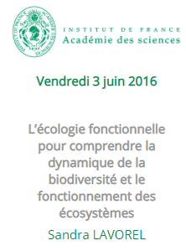
Digression
Functional ecology to understand biodiversity dynamics and ecosystems functioning
=> 20’05
(5min)
=> 29’18
(5min)

Slide 20
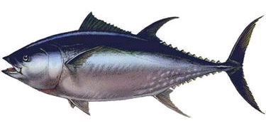
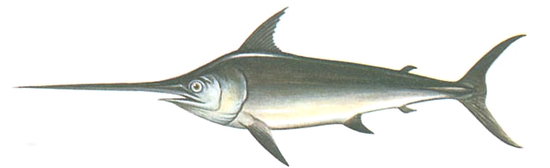
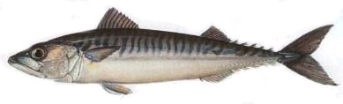
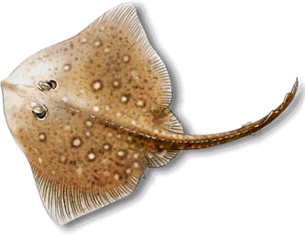
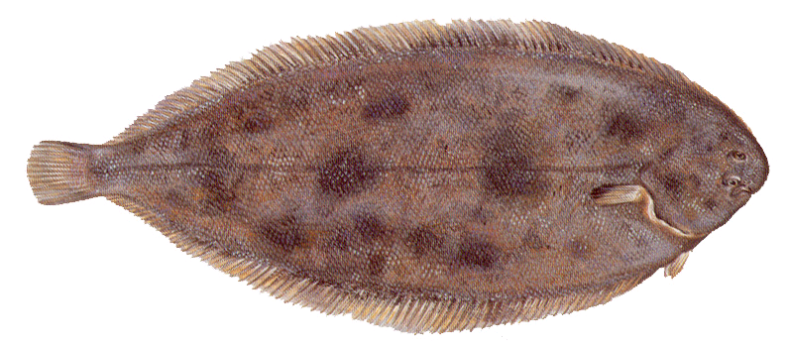
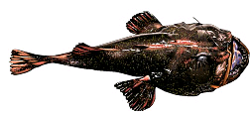
From morphology to ecology
Main biological traits: morphology - shape
In general: fusiform (torpedo-shaped) body = adapted to aquatic life
Tuna
Mackerel
Swordfish
Exception: a few species that live on or near the bottom
Ray
Sole
Anglerfish

Slide 21
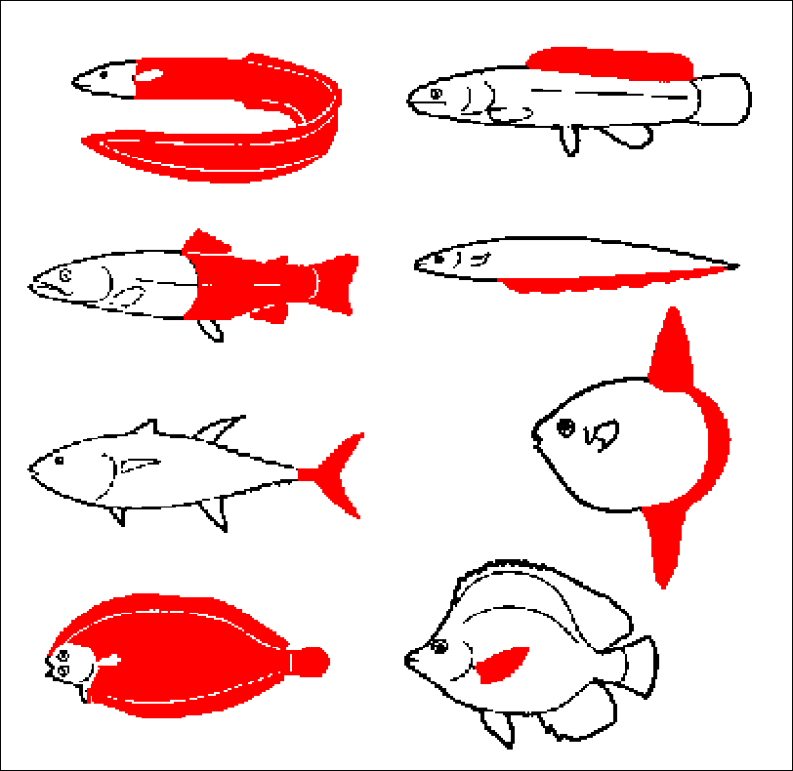
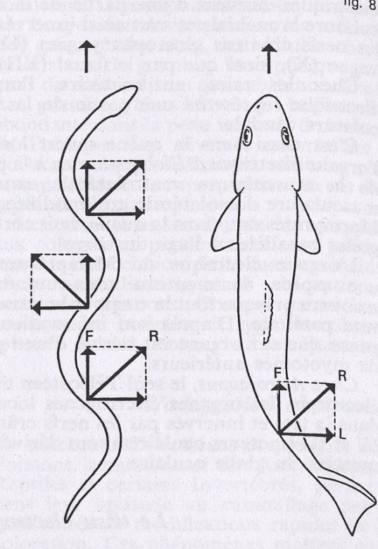
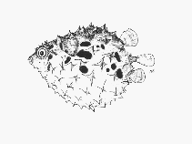
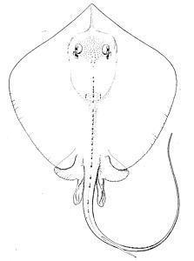
From morphology to ecology
Main biological traits: swimming pattern
Body and/or fins movements
Propulsion modes
acceleration vs cruising capacities
In red: propulsion components
Resolution of swimming forces
Eel Trout
(schema) (dorsal view)

Slide 22
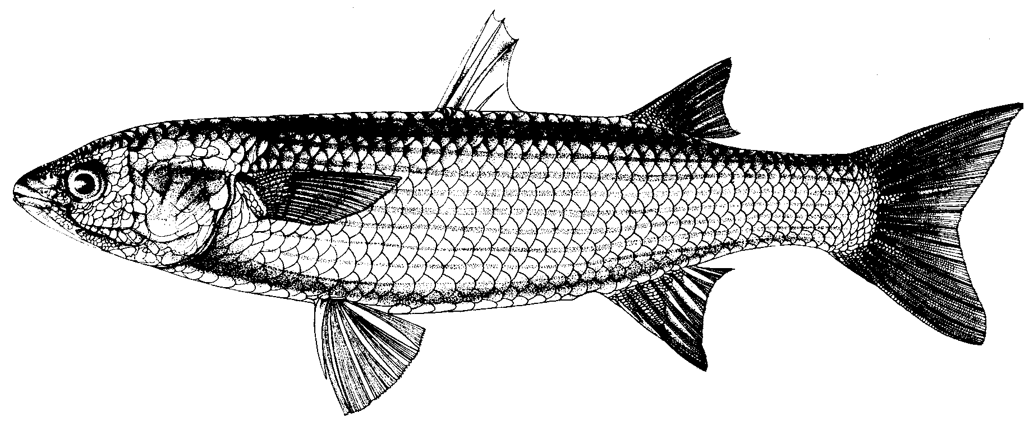
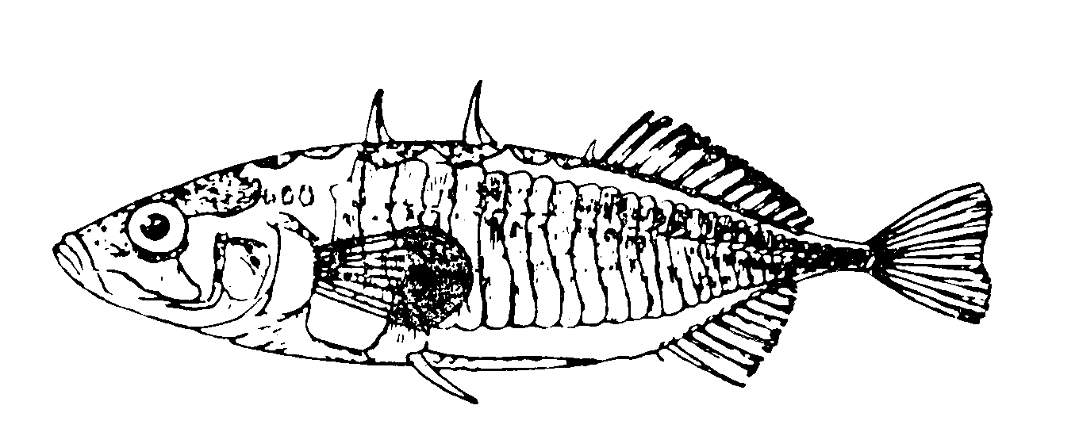
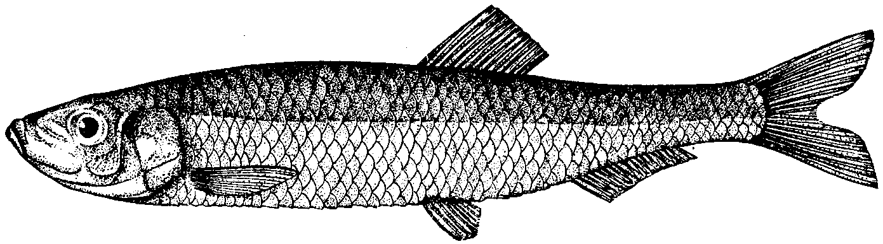
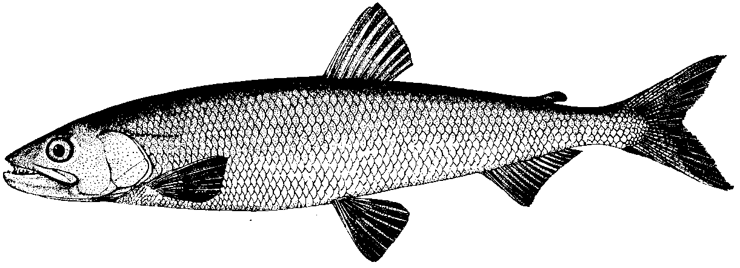
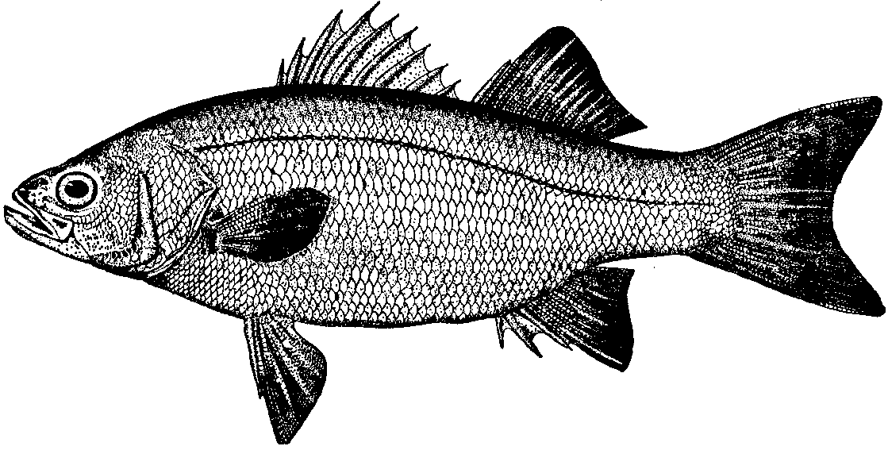
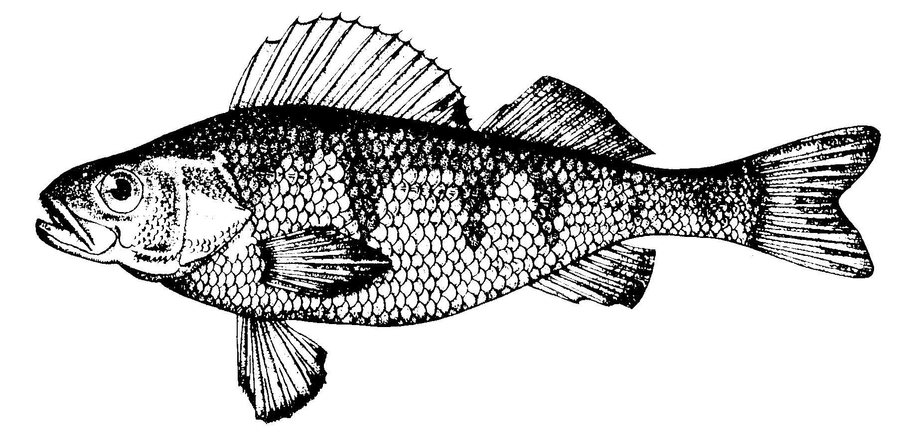
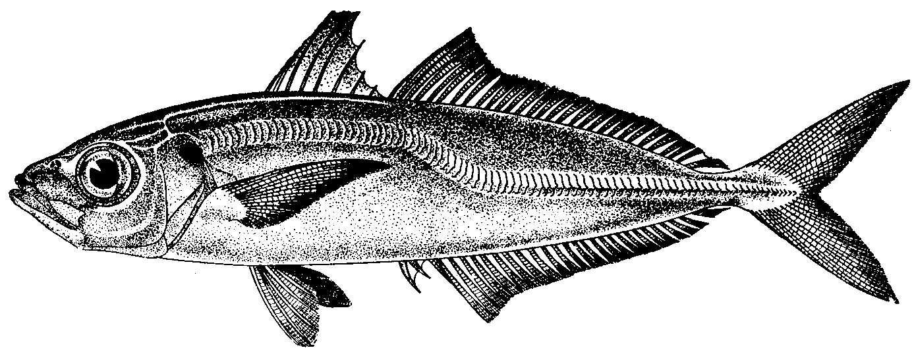
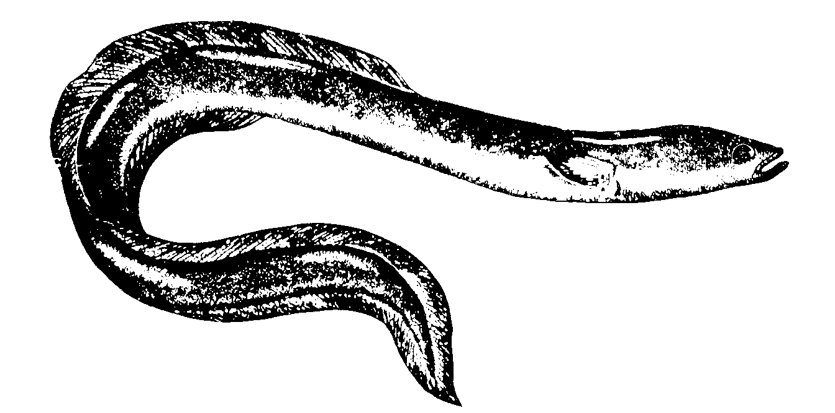
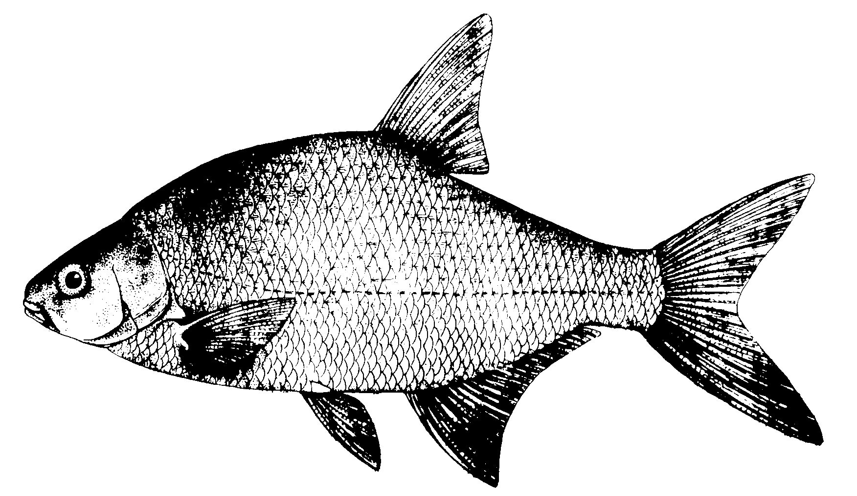
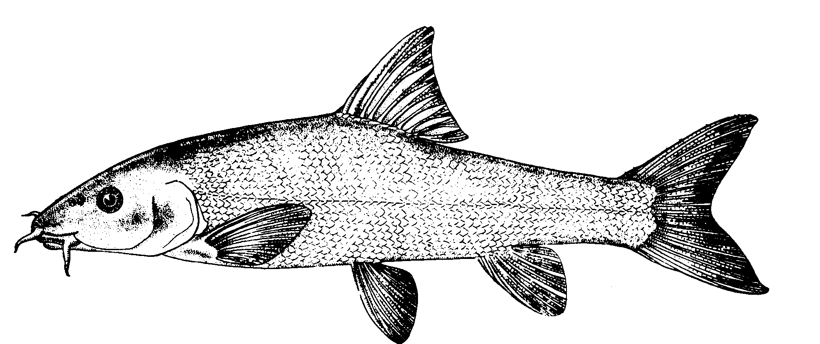
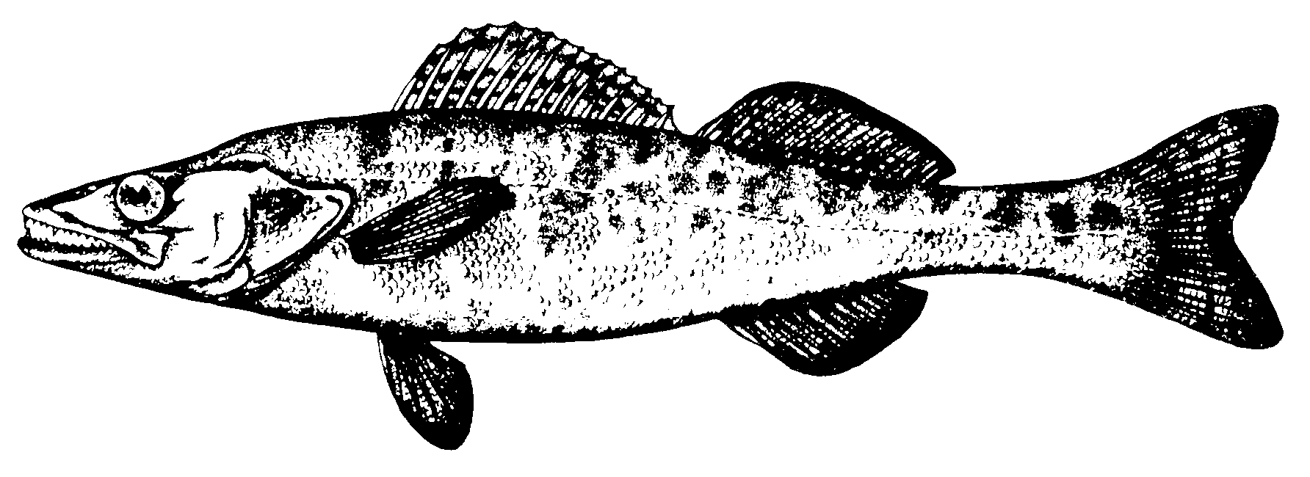
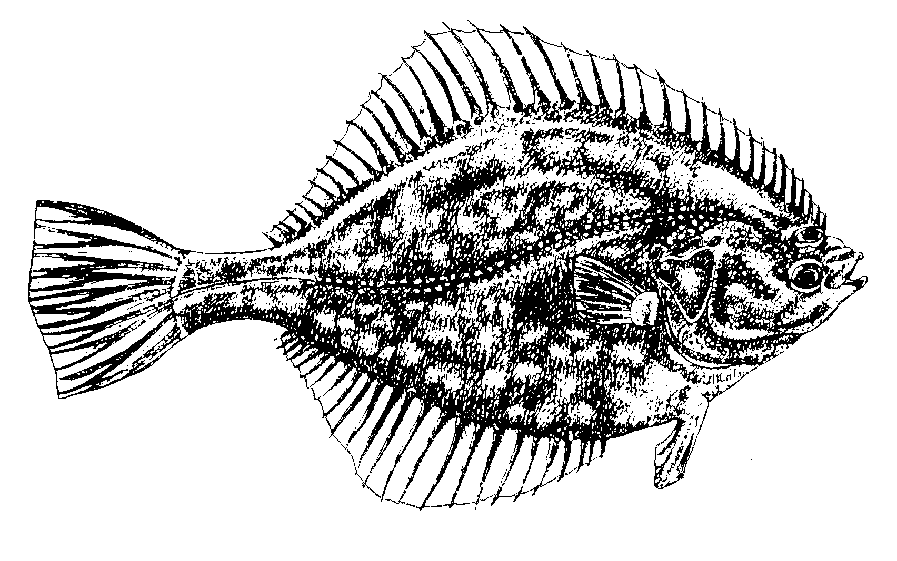


From morphology to ecology
Position in the water column
PELAGIC
DEMERSAL
BENTHIC

Slide 23

From morphology to ecology
Position in the water column… and diet
Plankton
Bacteria & diatom
Fish
Omnivorous
Shellfish
Worm & Mollusc

Slide 24








Various ecological guilds
Various groups … various uses of estuaries
In the Loire estuary
Resident
10%
Entire life cycle (reproduction, nursery, growth, feeding)
Diadromous
Migrations ocean <=> river (migratory corridor, nursery, feeding, growth)
19%
Freshwater
Accidental occurrence in the haline part (feeding)
→ survival?
14%
Marine
Mainly juveniles (nursery, refuge)
& some adults (feeding)
57%
=> 25’05
(5min)
In the Gironde estuary

Slide 25


Various ecological guilds
Marine species
Regular presence in estuaries, under certain conditions (temperature, seasons, …)
Nursery for juveniles and/or adults (predators)
Reproduction zone
    In the Gironde estuary: 21 species found (Meagre, Whiting, Sole, Sprat, …)
      Some economic interest for the major marine fisheries
Anchovy Engraulis encrasicolus
Sea bass Dicentrarchus labrax

Slide 26


Various ecological guilds
Marine species
    Example of the common sole lifecycle
Metamorphosis
Colonisation
Spawning
Recruitment
Nursery
Spawning area
Figure 1. Sole Life Cycle (From Durieux, 2007) and Critical phases (in Red and Blue; Source : C.Gaudard

Slide 27

Various ecological guilds
Diadromous species
«Species that are able to pass periodically, at well-defined stages of their life histories,
from salt to fresh water and vice-versa»
(Fontaine, 1976)
Estuary
Anadromous
Catadromous
Ocean
Fresh water
(9min)
At least, two passages in estuary to complete their life cycle

Slide 28


Various ecological guilds
Freshwater species
  Occur accidentally in the estuary
  ─ Floods (Pikeperch)
  ─ Dryness (Stickleback)
  Link between estuarine wetlands and river axis:
  ─ Persistence of tidal vector
  ─ Tidal range
  ─ Mudflats
      Survival ?

Slide 29
Variability in space and time
A key transitory habitat (Gili 2002)
Species presence is variable:
At seasonal scale (diadromous, marine species)
From year to year (in relation to climate, hydrology)
Depending on ontogenic stage (ex. marine juveniles)
Fish occur in estuaries when environmental conditions are suitable,
depending on their ontogenic stage.

Slide 30

Variability in space and time
Within estuary variability
The total species richness increases with salinity.
From Delphine Nicolas, 2010
Notes:
Schéma de la RS au sein d’un estuaire

Slide 31

Variability in space and time
Within estuary variability
The total density is structured by salinity
Illustration from Delphine Nicolas, 2010
Notes:
Schéma de la RS au sein d’un estuaire

Slide 32




Variability in space and time
Between estuary variability
The total species richness increases with estuary size (Nicolas et al., 2010a;b)
River discharge correlated with estuary surface area, proxy of habitat diversity (Monaco et al., 1992 ; Wootton, 1998 ; Roy et al., 2001) :
  Nature of substrate
  Presence of intertidal flats, seagrass beds, salt marsh (Pihl et al., 2002)
  Water quality: continuity of the salinity gradient
Goyen
Goyen
Intertidal
areas
Gironde
Gironde
Estuary size
Notes:
Schéma de la RS au sein d’un estuaire

Slide 33
Variability in space and time
Between estuary variability
The total species richness increases with estuary size (Nicolas et al., 2010a;b)
River discharge correlated with estuary surface area, proxy of habitat diversity (Monaco et al., 1992 ; Wootton, 1998 ; Roy et al., 2001) :
  Nature of substrate
  Presence of intertidal flats, seagrass beds, salt marsh (Pihl et al., 2002)
  Water quality: continuity of the salinity gradient
Mouth width
Estuary access promoted (Pease, 1999 ; Roy et al., 2001)
Longer penetration of marine waters upstream
Olfactory attractivness
Large fluvial plume may attract more marine species than small fluvial plume(Boehlert & Mundy, 1988; Tosi et al., 1990 ; Tosi & Sola, 1993 ; Le Pape et al., 2003)
Notes:
Schéma de la RS au sein d’un estuaire

Slide 34






Variability in space and time
Between estuary variability
The total density increases with the proportion of intertidal zones
(Nicolas et al., 2010b)
  Most fish in estuaries feed on benthic invertebrates (de Sylva, 1975; Elliott & Taylor, 1989b).
  The intertidal area constitutes the dominant feeding area for the estuarine fish populations (Costa & Elliott, 1991).
Benthos biomass
(4 min)
(6 min)
Intertidal area
Subtidal area

Slide 35


Variability in space and time
Seasonal variability
Longitudinale distribution :
strong seasonality
Example of the Seine estuary
(number of species)
33
Dominance of marine fish downstream
and freshwater fish upstream
UPSTREAM
25
24
19
DOWNSTREAM
Winter Spring Summer Autumn
Rochard et al., 1997
Villanueva, 2004

Slide 36
The use of estuaries by fish
Synthesis
Estuaries as reproductive zones
    Essentially for resident species
      Ex. gobies
    Flounder?
Estuaries as nursery areas
    Essential habitats
    For juveniles
    Essentially marine species but also FW and DIA
      Sole, bass, meager, …
      Shads, sturgeon, flounder
    Intertidal areas, subtidal and water column
    Essentially benthic invertebrates, zooplankton
Estuaries as feeding zones
    Seasonal variations
      Ex. conger, small sharks, hake, gurnard, anchovy, sprat …
I & II production
Food web dynamics

Slide 37

Summing up
(8min)

Slide 38

2. Long term changes in Estuarine Ecosystems (EE)
^{The Gironde}

Slide 39
Global Changes in EE
Habitat
and its modifications
Habitat modifications influence ecological communities
?
Consequences on ecosystems ?
Ecological communities
Structure
Spicies and functional diversity
Dynamics
Ecosystems
Functioning
Food web dynamics

Slide 40


Global Changes in EE
Etcheber, 2011; Goberville, 2010; Goberville et al., 2010; Sottolichio, 2009; David et al., 2007b
In 30 years
Changes in wind regimes (Northern Atlantic)
?
Reduced
rainfall
+2°C
In the Gironde
Le Treut 2013
Decrease in
river flow
Marine
intrusion
Increase in the upstream use of water
(Agriculture)
It is the marinisation of the estuary
?

Slide 41

Global Changes in EE
In 30 years
Changes in wind regimes (Northern Atlantic)
What are the likely consequences?
?
Reduced
rainfall
Lateral connectivity ?!
Maximum Turbidity Zone going upstream
Decrease in
river flow
Upstream-downstream connectivity!?
Marine
intrusion
Increase in the upstream use of water
(Agriculture)
Pollution
It is the marinisation of the estuary
?

Slide 42




Consequences on communities over 30 years
Pronier & Rochard 1998; Pasquaud et al. 2012; Chevillot et al. 2016
Meager
++
Smelt
++
0
0
Some species have appeared in the estuary… (ex. the meager, a subtropical species)
… while other species have disappeared (ex. the smelt, a cold water species)

Slide 43










Consequences on communities over 30 years
Anchovy
Meager
Sea bass
MARINE
Increase in marine species
Consequence of marinisation?
Allis shad
Twaite shad
Glass eels
Decrease in diadromous species
Environnement, fishing, pollution …?
DIADROMOUS

Slide 44









Consequences on communities over 30 years
Chevillot et al. 2019
PREY
Decrease in inter- and sub-tidal macrobenthos biomasses
FISH
Increase in marine fish biomasses
Is the trophic capacity of the estuary still sufficient?

Slide 45

30 years of change
Chevillot et al. 2017
Possible consequences of climate change
Abundance
Abundance
J
F
M
A
M
J
J
A
S
O
N
D
J
F
M
A
M
J
J
A
S
O
N
D
Shifts in seasonal peaks
(Edwards &Richardson, 2004, Nature )
Changes in residence time
And if the consequences of these changes are not the same for prey and predators ...
Abundance
Are prey still to the appointment?
Clic
J
F
M
A
M
J
J
A
S
O
N
D

Slide 46
Thank you for reading this presentation…

